Slide 1
PRIME VIDEO DASHBOARD
Unlocking Key Trends from 9,600+ Titles & 100 Years of Entertainment

Slide 2
INTRODUCTION
Title: Analysis of Amazon Prime Video Content Strategy
Subtitle: A Data-Driven Overview of 9,600+ Titles Spanning a Century of Entertainment
Key Points:
Overview: This presentation provides a comprehensive analysis of the Amazon Prime Video library, examining the platform's content acquisition and catalog structure.
Dataset Scope: The analysis is based on a dataset of 9,655 titles, featuring works from 5,771 directors across 519 distinct genres.
Timeline: The data covers a 101-year span of entertainment history, ranging from 1920 to 2021, offering insights into both classic archival choices and modern streaming trends.

Slide 3
OBJECTIVE
Uncovering Key Trends in Streaming Strategy
Key Points:
Content Composition: To determine the platform's strategic balance between Movies and TV Shows and identify the dominant format.
Audience Targeting: To analyze age ratings (e.g., 13+, 16+, R) and understand which demographic groups constitute the primary target audience.
Geographic Footprint: To map the global distribution of content and identify key regions of strategic investment (e.g., North America, Europe, India).
Growth Trajectory: To visualize the timeline of content additions and pinpoint the era of exponential library expansion.

Slide 4
DASHBOARD OVERVIEW
Amazon Prime Video Dashboard Overview
Data Scope: Analysis of 9,655 titles spanning 101 years (1920–2021), managed by over 5,700 directors.
Content Strategy: A clear "Film-First" approach, with Movies (81%) vastly outnumbering TV Shows (19%).
Growth Trends: The library shows exponential expansion starting in 2010, prioritizing modern content over archival classics.
Key Segments: The platform focuses on Drama and Comedy, primarily targeting Teen (13+) and Young Adult (16+) audiences globally.

Slide 5
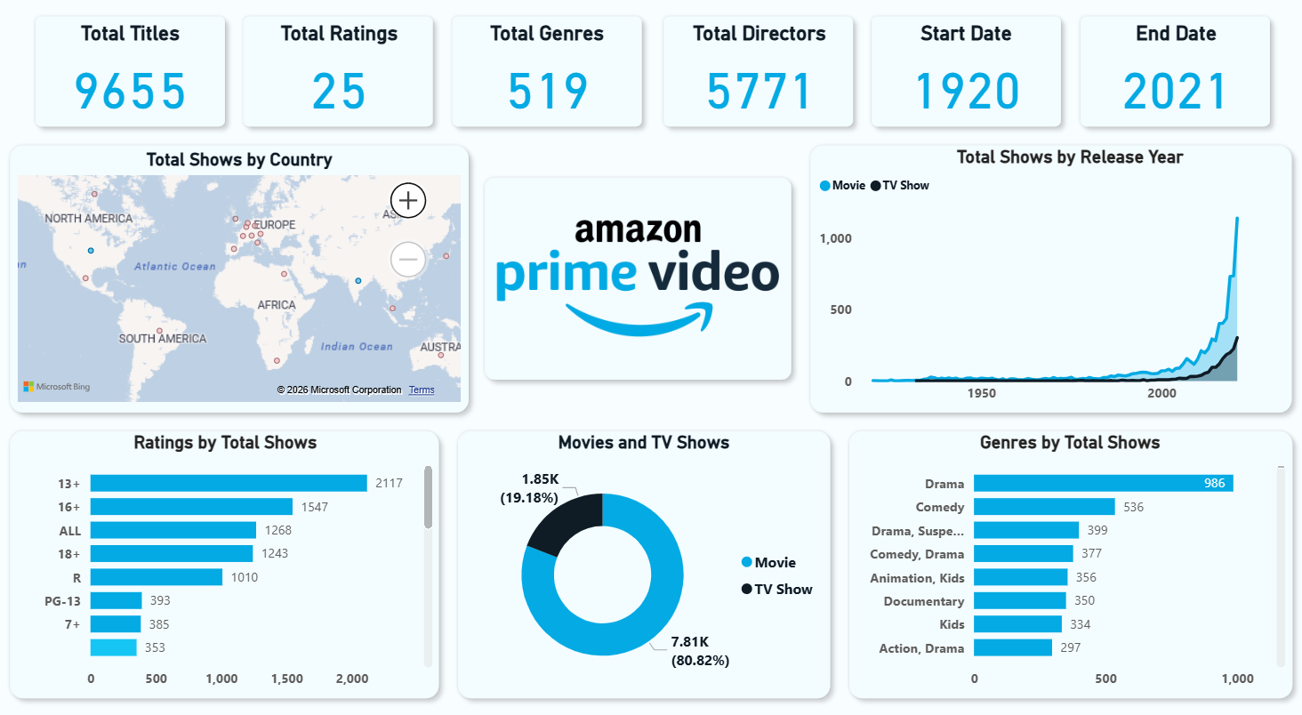

Slide 6
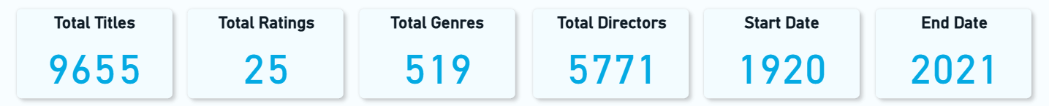
Massive Scale: The platform hosts a vast library of 9,655 titles, ensuring a deep catalog for users.
Rich Diversity: With 519 distinct genres and 5,771 directors, the content spans a wide variety of styles and storytelling voices.
Century of Entertainment: The library covers a 101-year span (1920–2021), offering everything from classic cinema to modern releases.
Broad Audience Reach: Content is categorized across 25 different ratings, catering to all demographics from toddlers to adults.

Slide 7
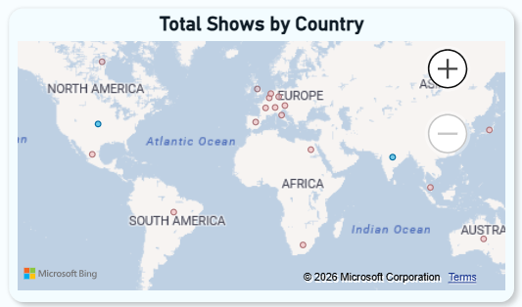
Expansive Library: 9,655 titles spanning 100 years and 519 genres.
Movie Dominance: A clear "Film-First" strategy with 81% Movies vs. 19% TV Shows.
Modern Surge: Exponential growth in content acquisition starting post-2010.
Target Audience: Primary focus on 13+ and 16+ demographics (Teen/Adult).
Top Content: Drama is the #1 genre; North America, Europe, and India are the key geographic hubs.

Slide 8
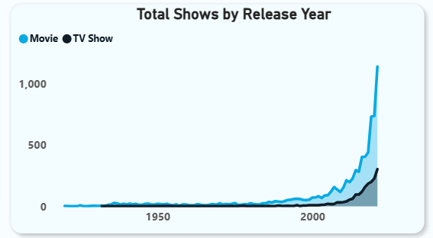
Exponential Growth Era: Content production remained relatively flat for most of the 20th century but saw massive exponential growth starting around 2000, peaking sharply in recent years (2019–2021).
Film-First Strategy: The volume of Movies (Blue) consistently dwarfs TV Shows (Black) throughout the entire timeline, confirming a heavy reliance on feature films to build the library.
Recent Content Spike: The steepest vertical climb occurs in the last decade, indicating that the vast majority of the platform's library consists of modern, recently released content rather than older classics.

Slide 9
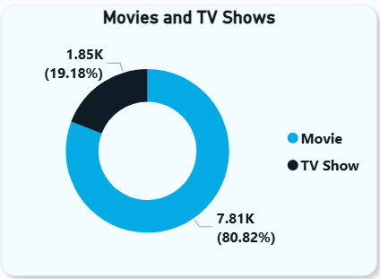
Movie-Centric Library: The platform is heavily skewed towards feature films, with Movies accounting for a dominant 80.82% of the total content (7,810 titles).
Selective TV Offering: TV Shows make up a smaller, curated portion of the library at 19.18% (1,850 titles).
Strategic Ratio: The 4:1 ratio of movies to TV shows suggests a strategy focused on offering a massive film vault rather than just binge-able episodic series.

Slide 10
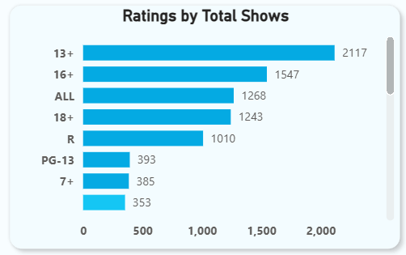
Dominance of Drama: The most popular genre by a significant margin is Drama, with 986 titles. This suggests that emotionally engaging, narrative-driven content is the platform's core strength.
Strong Comedy Presence: Comedy is the second-largest standalone category (536 titles), balancing the heavier tone of the drama library.
Rise of Hybrid Genres: There is a notable preference for mixed-genre storytelling. Categories like "Drama, Suspense" (399 titles), "Comedy, Drama" (377 titles), and "Action, Drama" (297 titles) show that audiences enjoy complex, multi-layered narratives rather than just single-genre plots.
Family & Educational Focus: Significant investment is visible in family-friendly content, with "Animation, Kids" (356 titles), "Kids" (334 titles), and "Documentary" (350 titles) all ranking in the top tier.

Slide 11
CONCLUSION
1. Content Strategy: "Cinema-First" Approach
The dashboard reveals a deliberate strategy to prioritize feature films, with Movies (81%) vastly outnumbering TV Shows (19%), positioning the platform as a massive digital cinema library.
2. Aggressive Modern Expansion
While the library spans 100 years (1920–2021), the "Release Year" chart confirms that the vast majority of content was acquired post-2010, showing a clear focus on modern, relevant entertainment over historical archiving.
3. Target Audience: Mature & Narrative-Driven
The data highlights a strong focus on Teen (13+) and Young Adult (16+) viewers. With Drama as the #1 genre (986 titles), the platform caters to audiences seeking serious, story-rich content rather than just casual viewing.
4. Global & Diverse Ecosystem
The "Country Map" and "Genre" charts prove this is a truly international service. With key hubs in North America, India, and Europe, and over 500 genres, the platform is built to serve a diverse, global subscriber base.

Slide 12
THANK YOU

